Slide 1
Examining the Causes of Human Migration
Katie Wallis, Philip Fang, Aman Jiddewar, Alex Su

Slide 2
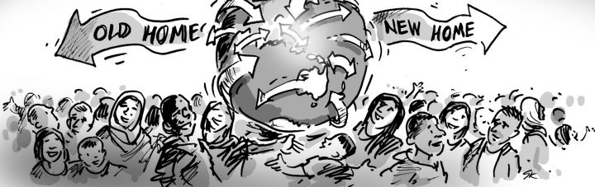
"Migration is an expression of the human aspiration for dignity, safety and a better future. It is part of the social fabric, part of our very make-up as a human family." -Ban Ki-Moon

Slide 3
Where Are People Migrating From and why?
Wanted to see what trends existed for certain countries
Which countries take in the most migrants?
Which countries have the most emigrants?
What factors influence people to migrant from their home country?
Deep dive into Syria, Mexico & India
Syria: War & Political Instability
Mexico: Crime & Corruption
India: Religion

Slide 4
DataSets
Overall Migration Dataset:
Country of Origin
Country & region of destination
Number of Migrants
Year
Syrian & Middle East Dataset:
A Geo-Referenced Dataset on Armed Conflict
Global Economy Data
Immigration Data on OECD
Mortality Data for Civil War
Mexico Dataset:
Homicide Rates
Corruption Rates
Crimes per State
Years
India Dataset:
Country of Origin
Country of Destination
Number of Migrants
Proportion of Religion
Growth of India(GDP,
Education, etc.)
Major Religion World Wide

